Slide 1
Cron Component
Koichi HARADA
4D Method Meeting
September 17, 2025

Slide 2

About Me
Self Employed Developer (4D and Web)
Software developer using 4D since 1998
4D Japan staff 8.5 years

Slide 3
I ❤️ component
Notes:
What situation and why, I decide to develop component.
Why I make them open source.

Slide 4
Progress Component
Wrapper methods for the 4D Progress component
Why – I wanted to access progress dialog from different process and/or sub-method
Additional feature:
  Automatically calculate remaining time
  Template literal (counter, end and timeRemaining)
Notes:
Why:
While debugging, sometimes I need to abort the process before Progress QUIT is called. Result is, I could not close progress dialog since I lost the id which is usually stored in local variable. So, I wanted to access the progress dialog from anywhere and anytime.
When method calls sub-routines, I wanted to launch a progress dialog in the parent and update title, message and progress in sub-routine. This can be done by passing progress id as parameter or store the id in process variable. But I felt it was not beautiful.
So, I take following solution.
When instantiate progress dialog, give a name, then store the name and progress id in shared singleton class (before in Storage). This way, I can retrieve an id corresponding a name, then I can update the progress value, title and message even from different process and/or sub-routine.
Additional feature:
If the process takes long time, you may want to give user feed back that shows how long it will take till the process finished. The Progress component calculate the time for you, based on max number, counter number and time elapsed.

Slide 5
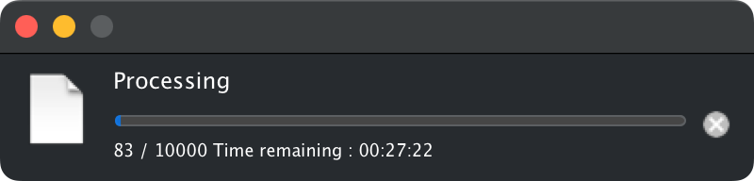
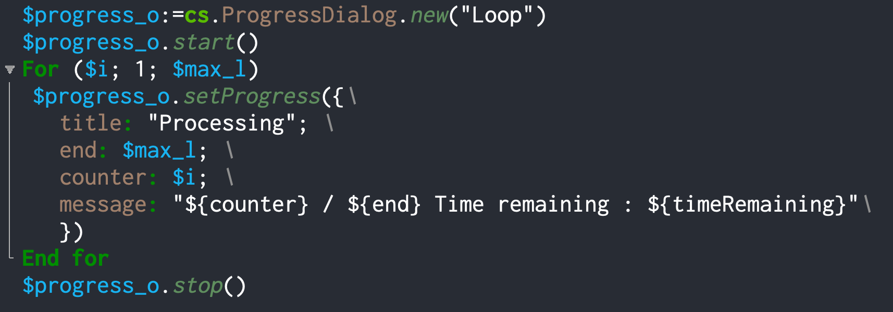
Progress Component
Notes:
Identify progress dialog by "name" instead of "id".
Access to the progress dialog instance and functions in class style programming.
Template literal.
Automatic "remaining time" calculation.

Slide 6
HTTPServer Component
Why – I feel defining routes in On Web Connection are bit complicated
Simple routing
  HTTP verb + Path
  No nesting Case of
1 additional thing: parsing request data
Notes:
Why:
Defining routes in On Web Connection using case of clause are bit complicated.
Sometimes nesting is needed.
Sometimes I lost which route needs authentication, and some doesn't.
I wanted to define routes more simple way.
I referred to Node.js Express which is a web developing framework and tried to implement what they have.
Additional feature:
Analyzing request.
Most of the web developing consists of the same task. Defining routes, analyzing request, construct response.
I wanted to make routing simpler as mentioned earlier, and because analyzing is always the same task, I've written codes for it once and don't want to do it again.
query string in URL
/api-name/parameter type URL
Request header, like cookie
Request body when the request is POST or PUT

Slide 7
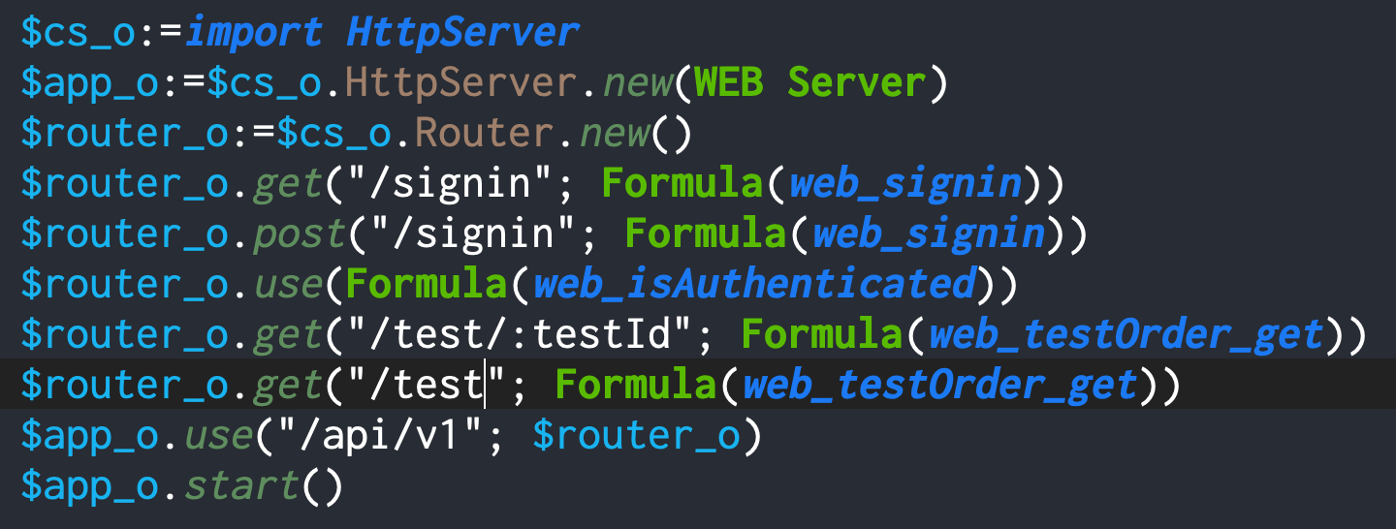
HTTPServer Component
Notes:
Routing definition based on HTTP verb and path
Router searches this table form top to bottom, then make a list of routes that matches with http verb and the path of the request.
"use" without path means always match. This is useful for authentication, for instance.
If auth failed, the method should redirect to sign in page or just return 401 Unauthorized response code.
If auth established, then you can call next route.

Slide 8
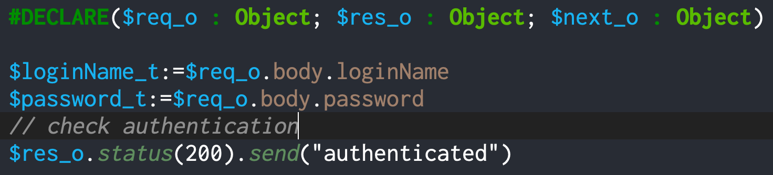
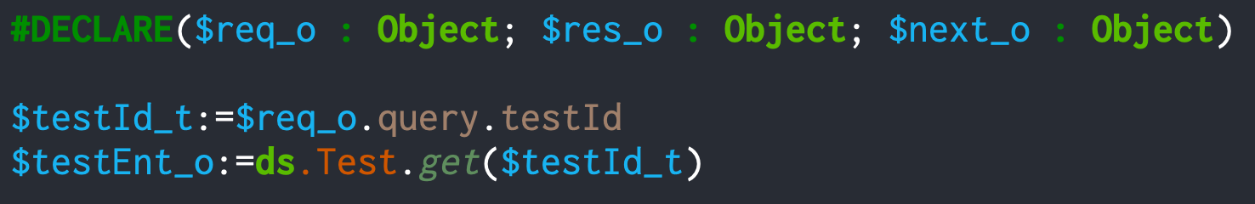
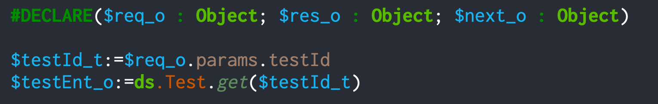
HTTPServer Component
Notes:
Common:
Every method passed as Formula parameter will be executed when the route matches the request path.
The method receives "Request", "Response" and "Next" object.
Request contains data receives via request, like request header (cookie, host and etc) and/or request body if any.
Response is used to construct response and send it back to the user agent.
Next is 4D.Formula object that contains formula passed to the next match route.
Fig1
Request body data of POST request are stored in the Request.body.
Fig2
Query string of GET request are store in the Request.query.
Fig3
Data in path (/api-name/:parameter) are stored in the Request.params.
Many other option for analyzing request. If you interested, please refer to the doc for the component and have a try.

Slide 9
Cron Component
Why – I needed to execute specific function periodically
  Observes a folder and read transferred files
  Sends e-mails in the que
  Produces daily or monthly report
  Updates hospital admission information in the morning
1 additional thing: variety of interval definition
Notes:
Why:
It's easy to implement using periodic execution using DELAY PROCESS. In that case the gap might be "every nn sec or min".
I wanted to define "at hh:mm" type intervals.
Also, I needed to solve the problem which is, if the daemon process is aborted unexpectedly, someone must re-invoke it automatically without user interaction.
Additional feature:
Variety of interval options
nn (in seconds)
at hh:mm
on the nnth day at hh:mm
every nn sec|min|hr
every weekname at hh:mm <= new

Slide 10
Cron Component
Demo
Notes:
I will explain with live demo
interval options
how this component works internally
what was changed with 20R7 repository. Mainly adopting shared singleton.
alert: be careful with energy setting

